Slide 1
Putting Alabama’s Plan 2020 to Work
in a Positive Manner with Positive Results:
Teachers & Politicians Unite!
Mary Scott Hunter
Alabama State Board of Education
www.maryscotthunter.com
Suzanne Culbreth
2013 Alabama Teacher of the Year
sbcteach30@gmail.com

Slide 2
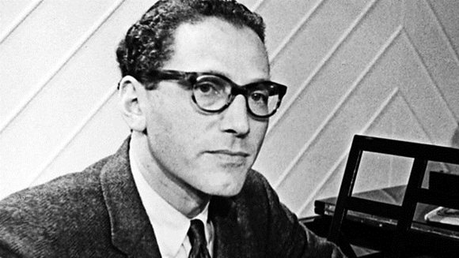
1965
Notes:
Hyperlink to YouTube video of New Math song:
https://www.youtube.com/watch?v=UIKGV2cTgqA (stop @ 2:26)
Tom Lehrer Born April 9, 1928
An American singer-songwriter, satirist, pianist, and mathematician.
“New Math” song was part of his 1965 album That Was the Year that Was
He has lectured on mathematics and musical theater.
He is best known for the pithy, humorous songs he recorded in the 1950s and '60s

Slide 3
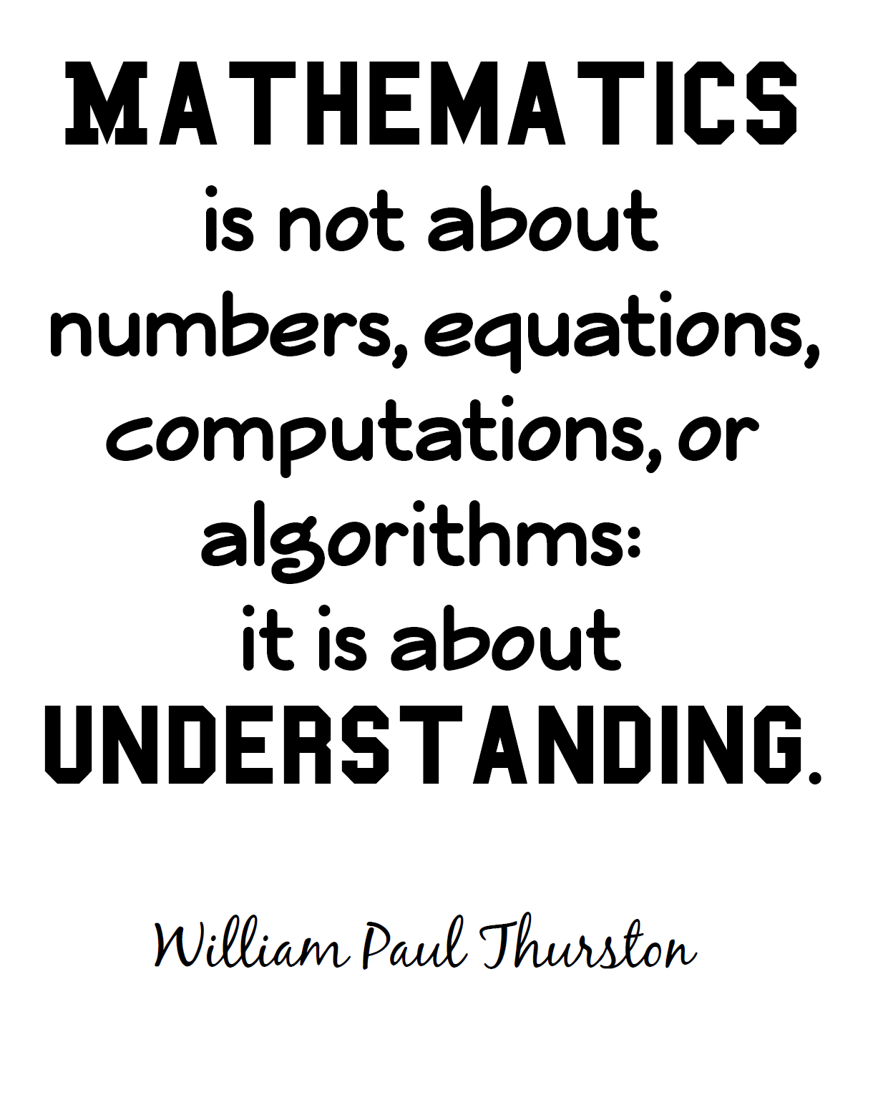
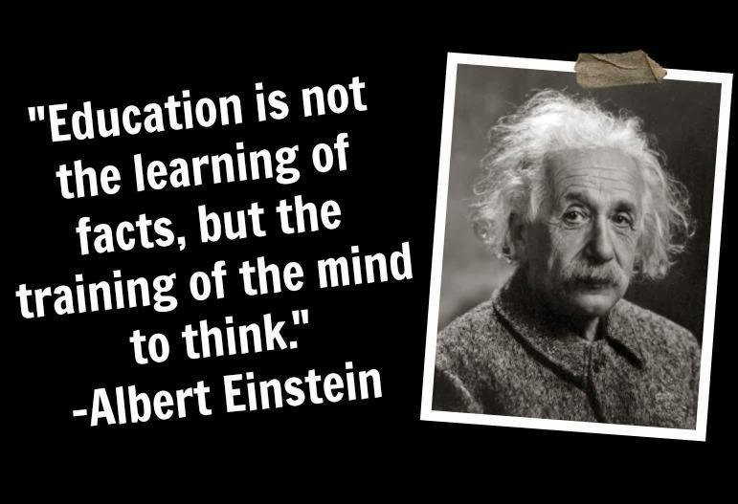
Notes:
Hyperlink to article:
http://www.usatoday.com/story/opinion/2014/09/15/common-core-math-education-standards-fluency-column/15693531/
USA Today - Solomon Friedberg is chair of the Math Department at Boston College

Slide 4
“65% of class should be student-to-student interaction….
research has proven that communication is vital to student learning. Knowing that this is true, classrooms should be arranged in groups of four and not in rows.”
Tim Kanold

Slide 5
Examine The Disconnect
Language 97%
Math 97%
Reading 97%
Science 97%
Social Studies 97%
English(18) 66%
Math(22) 31%
Reading(22) 41%
Science(23) 30%
All Four 20%

Slide 6
Of the roughly 86% of Alabama’s 2012 high school graduates who took the ACT, only 18% met all four college readiness benchmarks in English, Reading, Mathematics, and Science.
ACT, Inc. The Condition of College and Career Readiness 2012: Alabama, available at http://www.act.org/newsroom/data/2012/states/pdf/Alabama.pdf (2012).

Slide 7
College Readiness
Only 25% of graduating High School students were ready for college in all four areas. In Alabama, only 18% were completely ready.

Slide 8
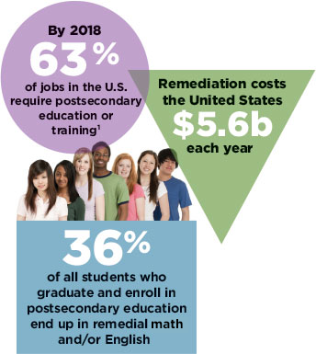

Slide 9
Alabama State Board of Education

Slide 10
Our Vision
Every Child a Graduate – Every Graduate Prepared
for
College/Work/Adulthood in the 21st Century

Slide 11
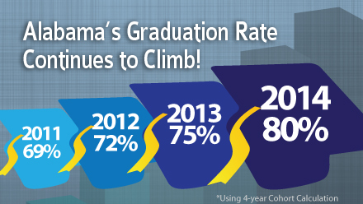
GOAL: 90% Grad Rate by 2020
600 additional students graduate for every 1% increase

Slide 12
Prepared Graduate Defined
Possesses the knowledge and skills needed to enroll and succeed in credit-bearing, first-year courses at a two- or four-year college, trade school, technical school, without the need for remediation.
Possesses the ability to apply
core academic skills to real-
world situations through collaboration with peers in problem solving, precision, and punctuality in delivery of a product, and has a desire to be a life-long learner.

Slide 13
Alabama’s PLAN 2020 Priorities
ALABAMA’S
2020
LEARNERS
ALABAMA’S
2020
SUPPORT SYSTEMS
ALABAMA’S
2020
PROFESSIONALS
ALABAMA’S
2020
SCHOOLS/SYSTEMS

Slide 14
Alabama College and Career Ready Standards

Slide 15
Who Authored?
National Governors Association
Council of Chief State School Officers
When?
Alabama reviewed in 2009/10
Alabama adopted ACCRS which include CCSS in 2010
Reaffirmed ACCRS in 2011
Why?
Because America is in danger of falling behind as we compete with our neighboring states and globally

Slide 16
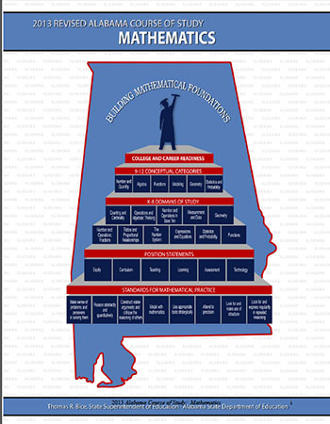
The Alabama College and Career Ready Standards are controversial here in Alabama because of their alignment with the Common Core State Standards.
The Common Core State Standards are controversial nationally.

Slide 17
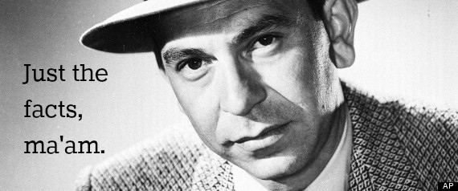
Alabama College and Career Ready Standards
Unique to Alabama
Only Math and English Language Arts
Alabama Board of Education Controls Standards
Locals teachers determine Curriculum
Current standards are better/stronger than before
No Common Core Testing in Alabama
No giant government conspiracy
“Threshold” of what all students should know
No limit on classroom creativity
No limit on individual student achievement
Deeper learning and understanding

Slide 18
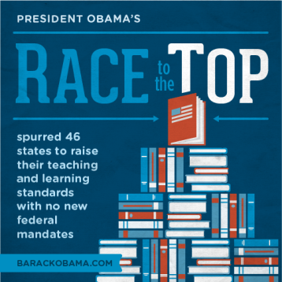
Alabama College and Career Ready Standards
Solutions to hard problems?
Change Perception that Washington is in control
Get the Facts out
Fight “Group Think”
Compromise by taking steps that reassure not derail
Keep the Main Thing the Main Thing
Achievement
Good Jobs
Prosperity

Slide 19
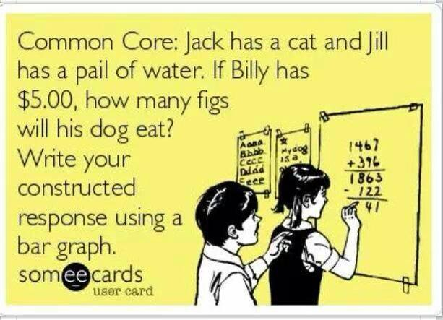
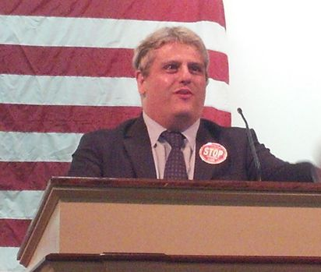
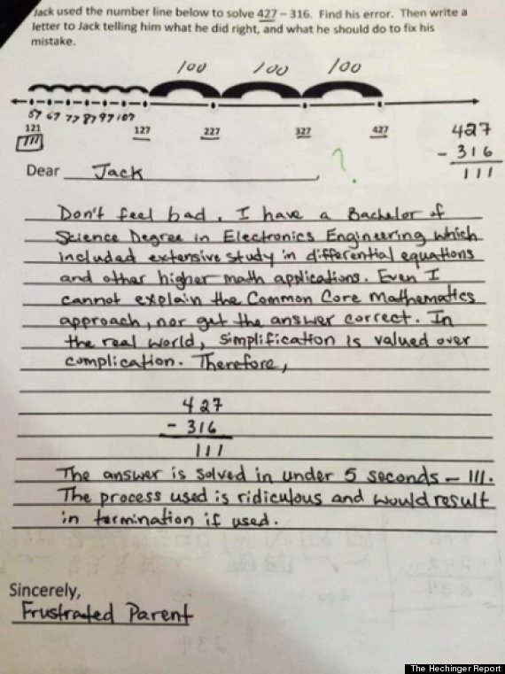
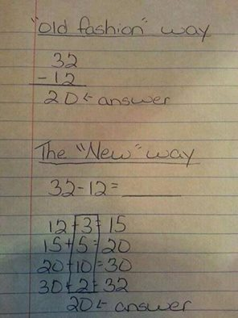
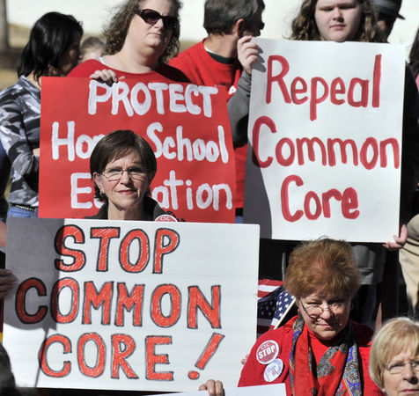
Notes:
Suzanne Culbreth...I have not seen the common core standards. All I have seen is math like you see here. I have a friend who took her daughter out of public school and is home schooling her. Her daughter went from an A student in math to a D student after her school changed to the common core standards. Suzanne, please shed some light on this for me.
“it is something that the federal gov't has come up with. I have never seen the standards but lots of people talk about them and post math problems like the one above. My niece Tricia teaches in Hattiesburg, MS and she posted that she had never seen any thing like the problem above”

Slide 20
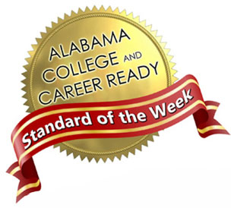
Contact your regional
Math Specialist
Notes:
Hyperlink to Resources:
ACCR site - http://alex.state.al.us/ccrs/
Standard of the Week - http://www.alsde.edu/sec/comm/Pages/standardoftheweek-all.aspx
AMSTI - http://www.amsti.org/
GRIT - http://www.alabamagrit.org/
ACTM - http://acotom.wildapricot.org/
A+ College Ready - http://www.apluscollegeready.org/
Teaching Channel - https://www.teachingchannel.org/videos/real-world-geometry-lesson
https://www.teachingchannel.org/videos/seating-arrangements?tab=1#video-sidebar_tab_video-notes-tab

Slide 21
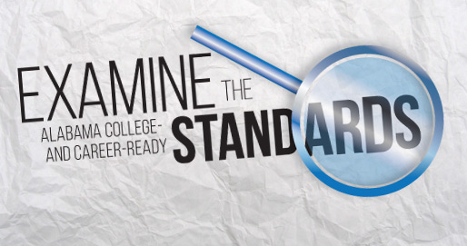
Notes:
Hyperlink to:
http://www.alsde.edu/dept/standards/Pages/home.aspx

Slide 22
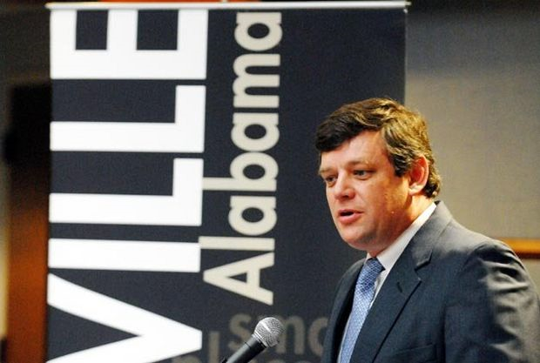
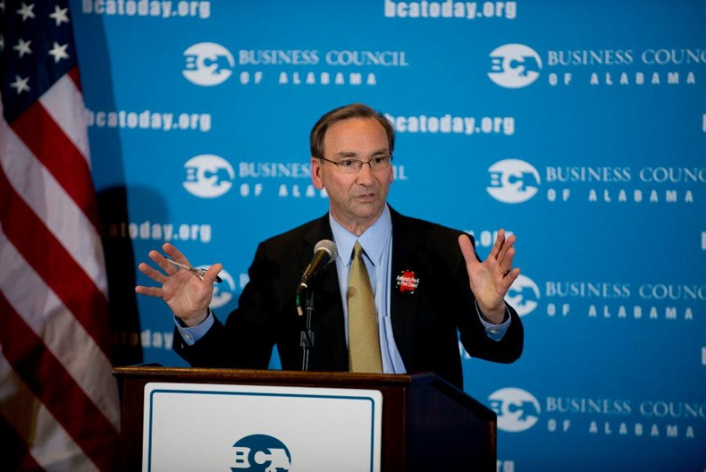
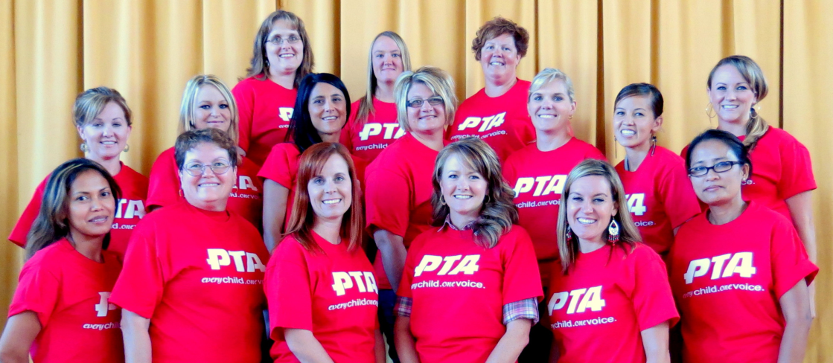
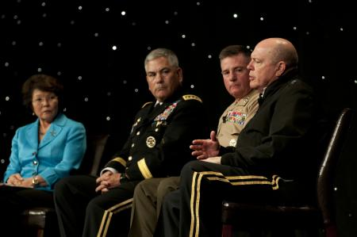
Proponents
Notes:
NOT Alone!

Slide 23
Proponents
Chamber of Commerce
Business Council of Alabama
Military Child
Education Coalition
PTA
K -16 Educators

Slide 24
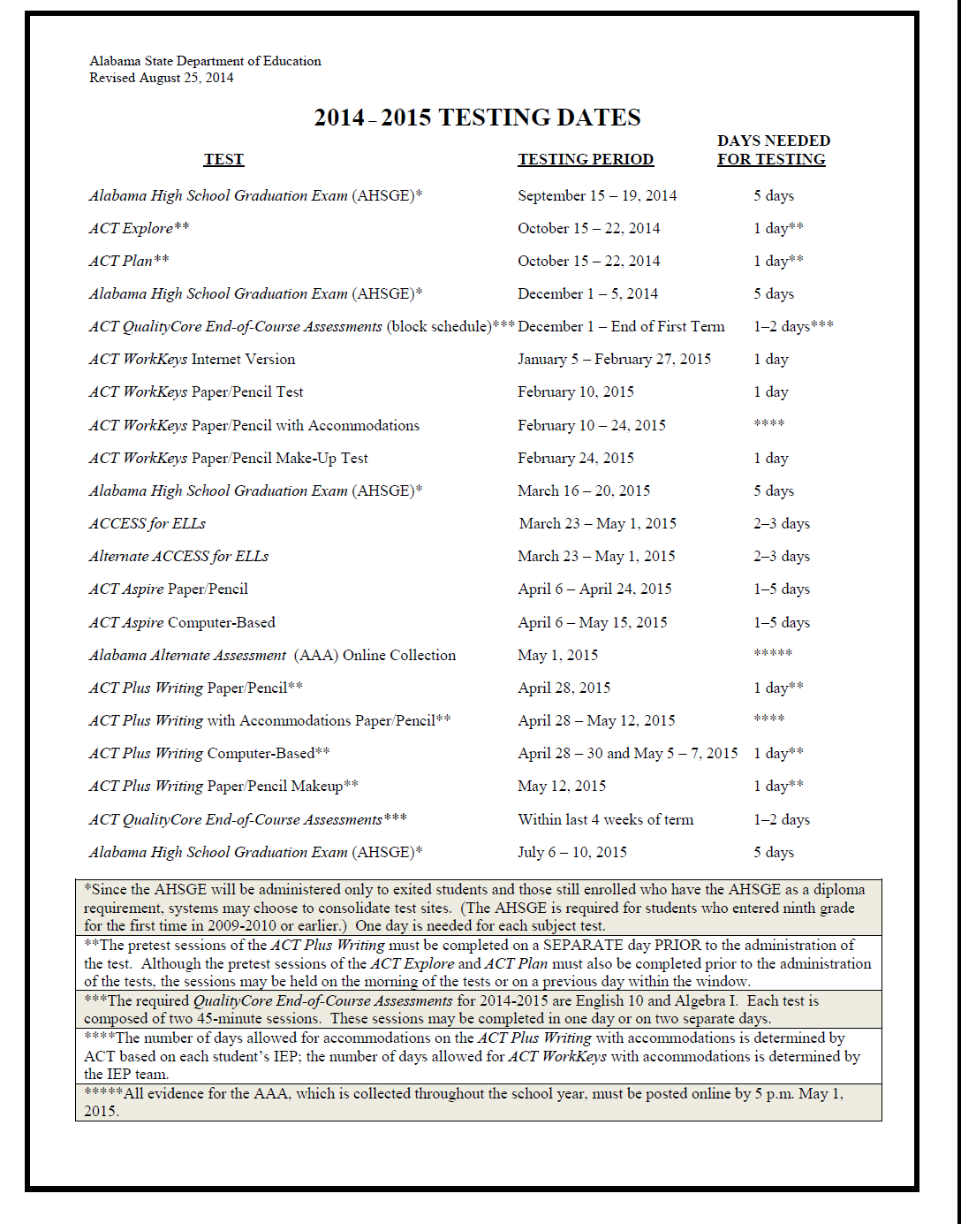
Notes:
Link to:
Product Details -> Test Items
http://www.discoveractaspire.org/assessments/test-items/

Slide 25
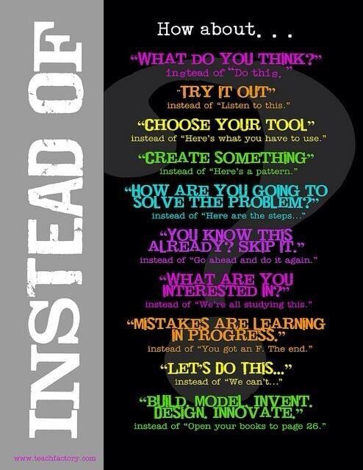

Slide 26
“All one can really leave one's children is what's inside their heads. Education, in other words, and not earthly possessions, is the ultimate legacy, the only thing that cannot be taken away.”
~ Werner Von Braun

Slide 27
?
Putting Alabama’s Plan 2020 to Work
in a Positive Manner with Positive Results:
Teachers & Politicians Unite!
Mary Scott Hunter
Alabama State Board of Education
www.maryscotthunter.com
Suzanne Culbreth
2013 Alabama Teacher of the Year
sbcteach30@gmail.com

